Slide 1
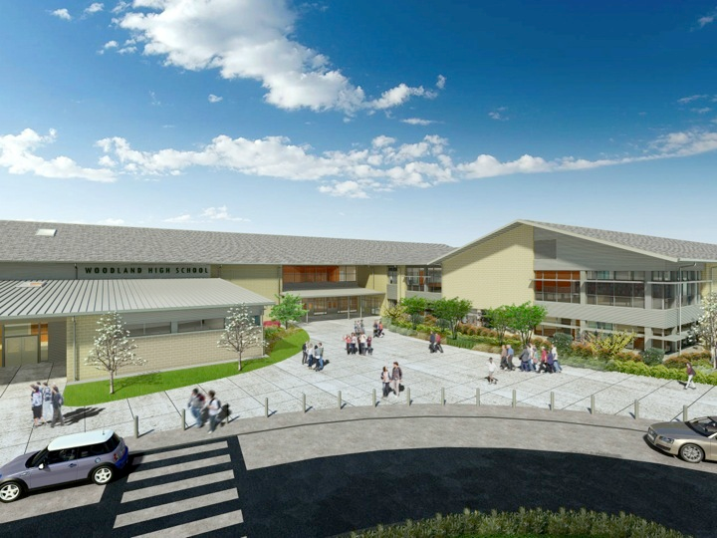
Woodland Public Schools
Facilities and Safety Report
September 2017

Slide 2
FACILITIES REPORT
Safety Committee The first safety committee meeting for the 17/18 school year was completed 12 October. At this meeting the team decided to increase the number of meetings from every two months to every month to get higher visibility of safety concerns. Additionally implemented last year, was a rotating school schedule for the meeting locations. The team breaks into groups at the conclusion of the meeting and inspects the school for safety deficiencies which has proven to be very beneficial. At our first meeting this year, numerous cross-campus issues were raised including, parking lot speed, earthquake preparedness, fire sprinkler clearances and safety equipment access. All These will be addressed via the district website and district email.
Security Cameras Security cameras are up and running at WMS and WIS. All cameras are running at WMS (52 cameras) and all the internal and one external cameras are running at WIS (18) The balance WIS exterior cameras should be running this week. Minor adjustments are being made to optimize zoom, focus and direction.
Portable Building Access New aluminum ramps were installed at WMS and WPS to address ADA access concerns and safe access to the buildings. The balance of the portables will get new ramps next summer. Each ramp assembly cost approximately 5k. The existing ramps were dry rotted and did not meet ADA landing and slope requirements. Including the new portables at WIS, 7 ramps have been installed in the last 2 years. 4 ramps remain to be replaced.

Slide 3
Facilities Report Continued
Boiler start up at WMS
Start up of the new boilers at WMS was delayed due to a late delivery of the new flues (boiler exhaust system). We expect startup to happen the week of 10/16. Once started, we will complete exhaust emission testing to satisfy the regulatory requirements and obtain permits.
Property at 2280 Lewis River rd.
An asbestos inspection was completed on the property acquired by the District at 2280 Lewis River Rd. adjacent to WIS. The inspection results proved negative for asbestos. We can now file a permit with SWCAA (southwest Clean Air Agency) and the City of Woodland and demo the house on this land. Once demolished, we will grade the lot and gravel.
Dust Collection
A health issue was identified at the WHS ceramics classroom. A fine coating of dust is always present in the room even after cleaning the to room. To address this a HEPA filtration system will be added to the room to trap fine dust particles and provide a safer environment for the staff and students. The middle school will also be evaluated to see if the same risk is present there.

Slide 4
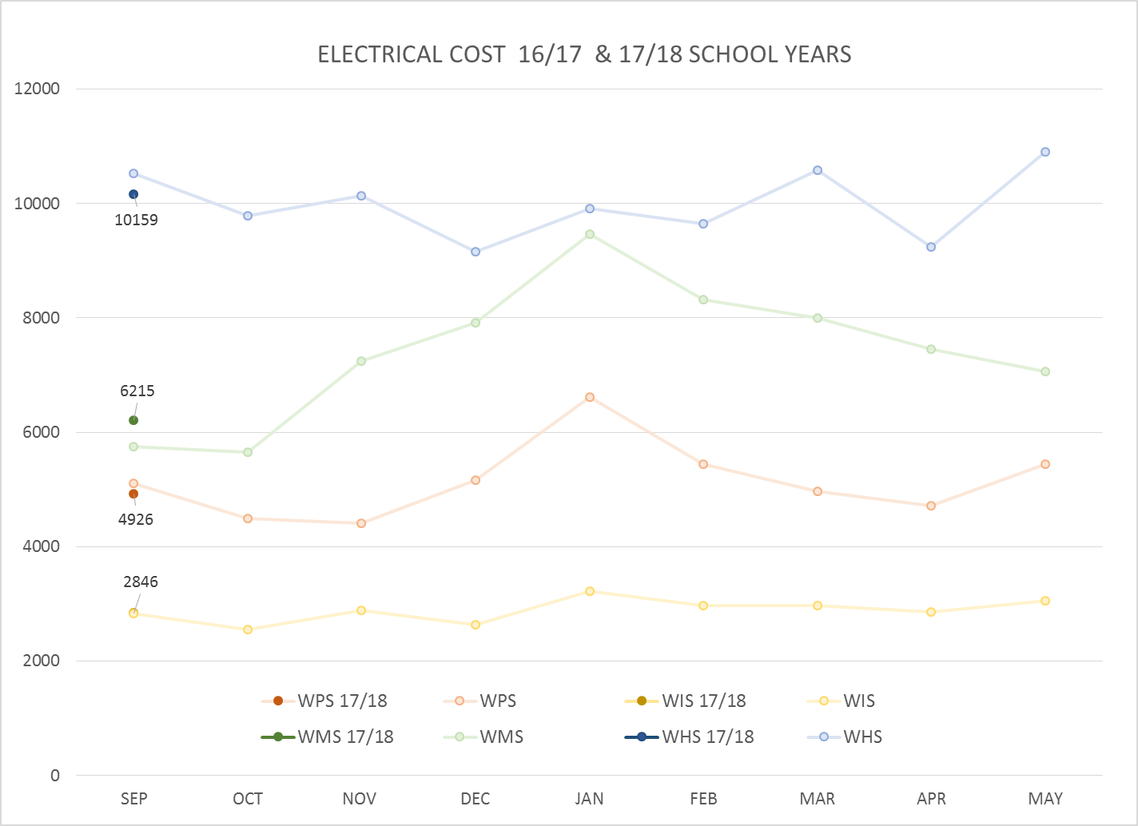
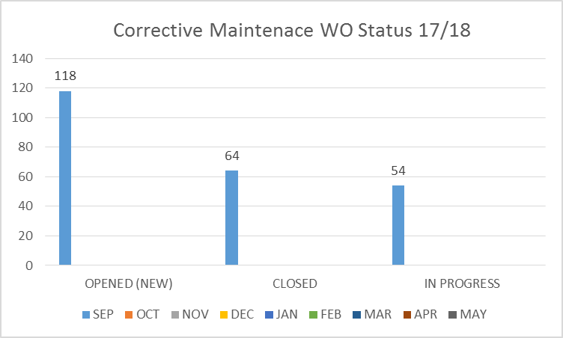
FACILITY CHARTS – POWER COST AND WORK ORDER STATUS

Slide 5
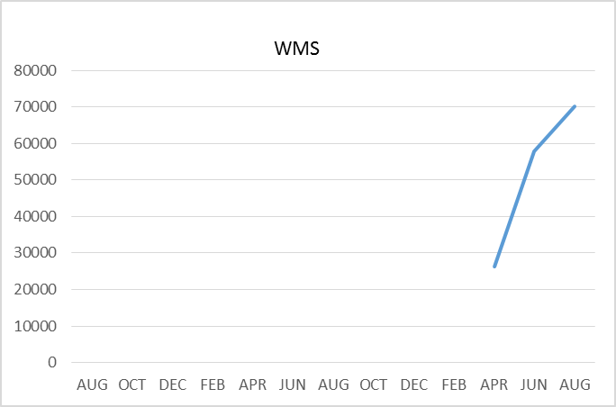
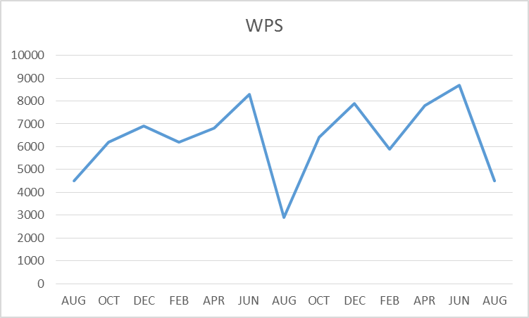
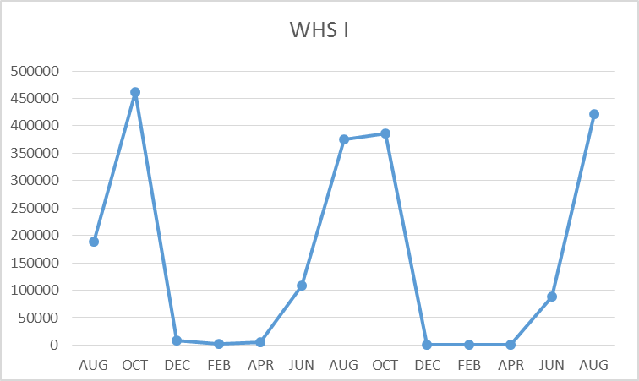
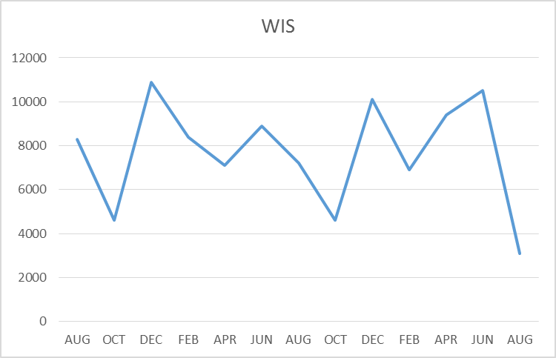
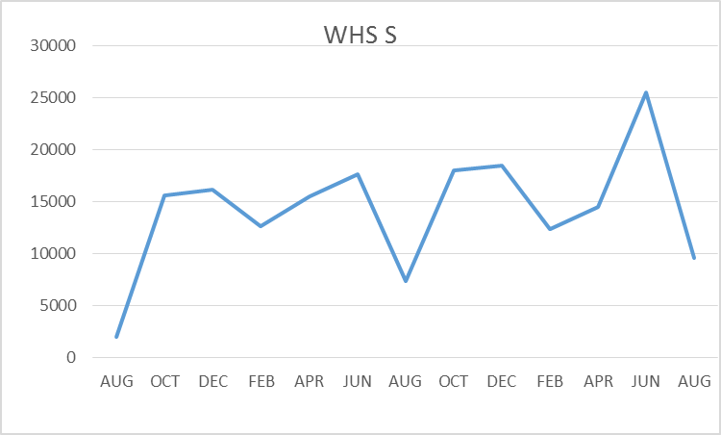
FACILITY CHARTS –
WATER USAGE
WHS, WIS, WMS, WPS
Water charts are updated every two
Months, next update to these charts
in November
The WMS chart has been reconfigured to include the following 7 meters: 755 park high and low flow, BO and Team High, Pit house, buss barn, athletic field and DO. All of these meters are totaled on the WMS graph but each data point is recorded separately to aid in identifying leaks. A large leak was found on the irrigation line on the Park street meter responsible for the large spike in AUG, balance of spike from April is due to irrigation.

Slide 6
SAFETY Report
Accidents for the month
There were a total of 15 injuries/incidents in the month, 3 student, 12 Staff
Staff Accidents/Incidents (12)
WPS – Multiple Employees hit/bit /scratched by students due to behavioral issues (10 incidents)
WIS – Employee slipped on water by drinking fountain
WIS – Student struck IA multiple times during intervention
Student Accidents/Injuries (3)
WHS – Student drank double energy drink and had racing heart, 911 called, student released to parent.
WHS – Football head injury, possible concussion, staff followed concussion protocol
PIT -Student drawing in sand with finger at Horseshoe Lake, stung by bee.

Slide 7
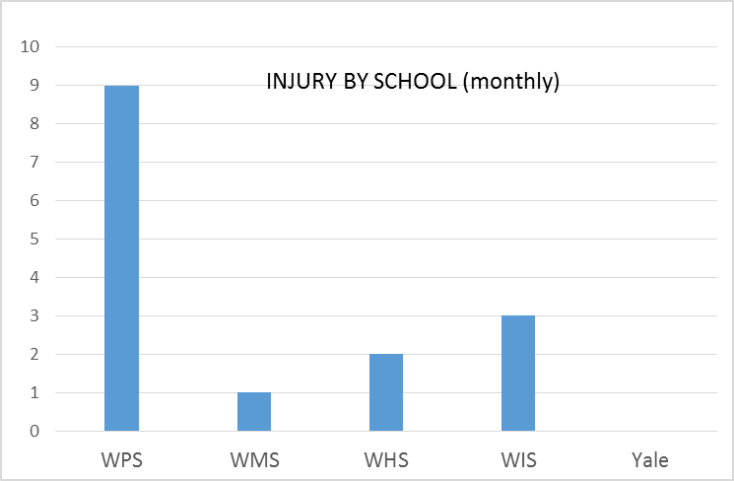
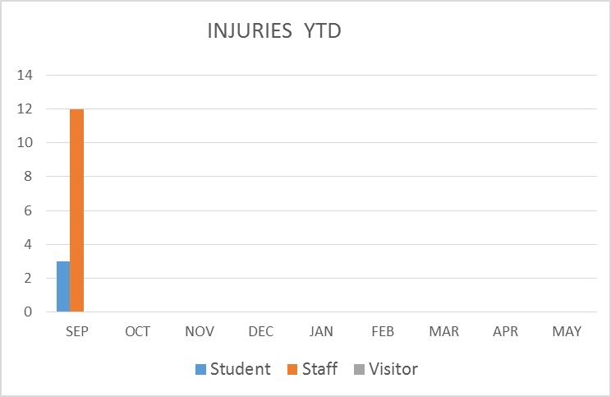
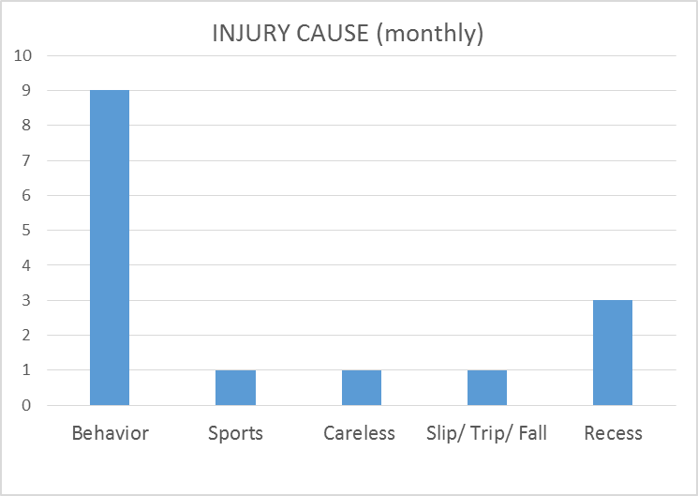
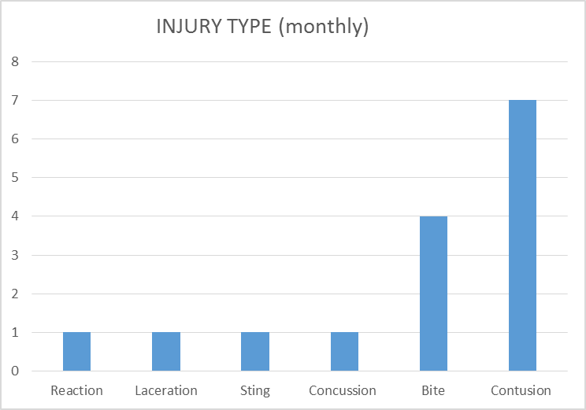
SAFETY CHARTS

